Slide 1

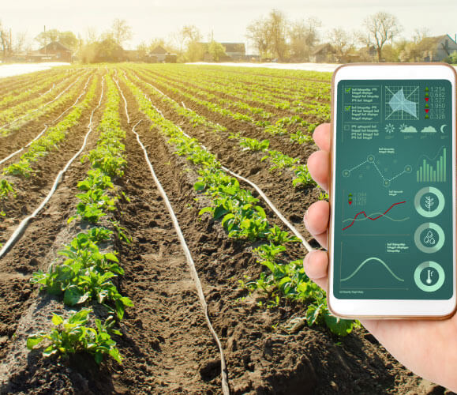
SMART BIO MONITORING SYSTEM
Group - G40
Submitted By -
AMAN SAINI (1900290130023)
VINAY SINGH (1900290130190)
SRIJAN JAISWAL (1900290130167)
TANUJ KUMAR (1900290130174)

Slide 2
Introduction
The aim of this project is to develop a system that automates and digitizes the field of agriculture, specifically targeting nursery farms.
Agriculture is a crucial sector that plays a vital role in ensuring food security and supporting the economy.
However, the adoption of automation in agriculture has been limited due to cost constraints.
This project aims to address this issue by providing an affordable and efficient solution for monitoring and controlling climatic conditions that directly impact plant growth and production.

Slide 3
Objectives
The project aims to address the significant challenge of crop fields by developing a smart plant monitoring system that utilizes automation and IoT technology.
To tackle this problem, the project focuses on creating a comprehensive monitoring system that continuously tracks crucial factors like soil moisture levels, air temperature, and soil temperature.
The smart plant monitoring system is designed to detect and identify any potential issues that may arise, such as excessive watering or exposure to extreme temperatures.

Slide 4
Limitations of traditional bio-monitoring methods in plant monitoring:
Traditional methods of plant monitoring also have limitations that can be addressed by smart bio-monitoring systems using IoT devices:
Inaccurate and infrequent measurements
Time-consuming and resource-intensive
Lack of real-time monitoring
Inability to track long-term trends

Slide 5
Hardware used
We have used different IOT Devices devices for different factors Such as:
Arduino
Soil moisture Sensors
Temperature and humidity sensors
Ultrasonic sensors
Infrared sensors

Slide 6

Aurdino
An Arduino is an open-source microcontroller development board.
Arduino utilizes a microcontroller as its core,
The microcontroller has built-in input/output pins for connecting electronic components.
These pins allow reading sensor data, controlling motors, activating lights, and interacting with other devices.
Arduino provides a user-friendly programming environment called the Arduino IDE.
The IDE simplifies the process of writing code for the microcontroller.
It uses a subset of the C++ programming language.

Slide 7
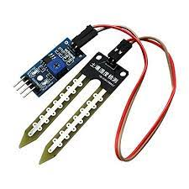
Soil moisture Sensors
A soil moisture sensor is a device that measures the amount of water present in the soil.
It works by measuring the electrical resistance or capacitance of the soil.
The sensor typically consists of two electrodes that are inserted into the soil and a circuit that measures the resistance or capacitance between the electrodes.

Slide 8
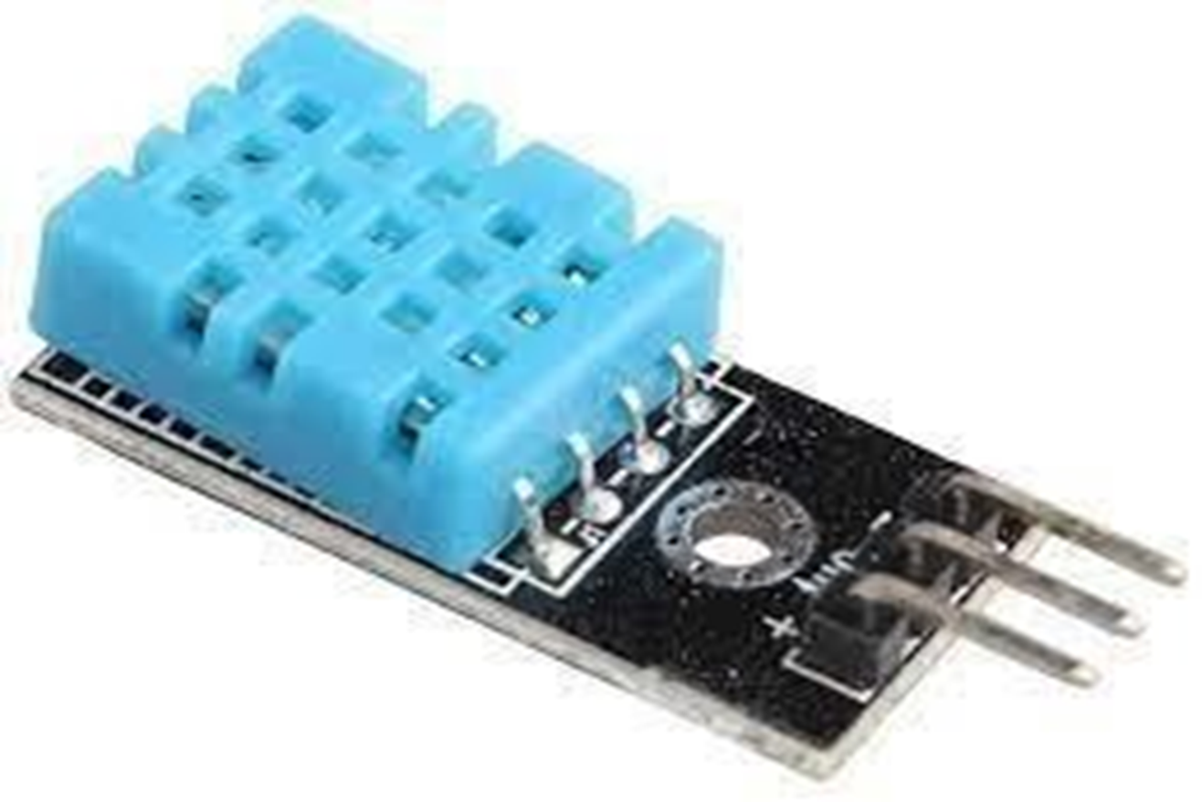
Temperature and humidity sensors
A temperature and humidity sensor is a device that measures both temperature and humidity in the surrounding environment.
These sensors typically consist of two main components: a temperature sensor and a humidity sensor.
The temperature sensor measures the ambient temperature, usually with a thermistor or thermocouple, which changes resistance or voltage as the temperature changes.
The humidity sensor measures the amount of water vapor in the air,

Slide 9
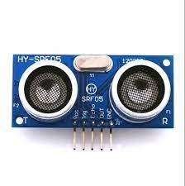
Ultrasonic sensor
An ultrasonic sensor is a sensor that uses sound waves to measure distance, speed, or other properties of objects.
Ultrasonic sensors use the principle of echolocation to measure distances and detect objects.
These sensors work by emitting a high-frequency sound wave, and then measuring the time it takes for the sound wave to bounce back (the time of flight) to calculate the distance to the object.

Slide 10
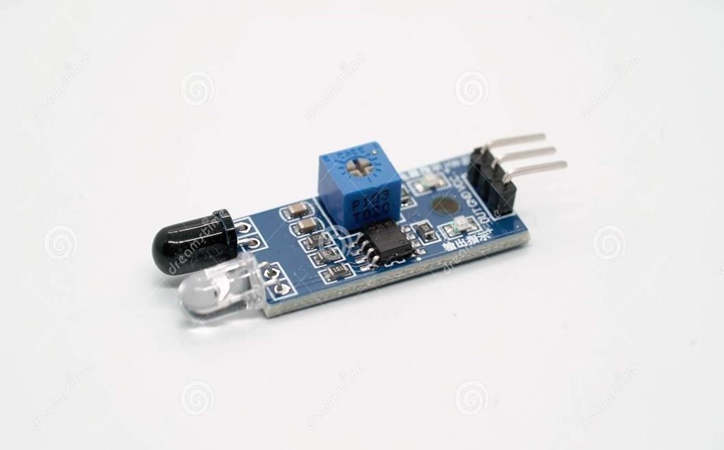
Infrared sensors
An infrared sensor is a device that detects infrared radiation, which is electromagnetic radiation with a wavelength longer than that of visible light but shorter than that of microwaves.
Infrared sensors are used in a wide variety of applications, such as remote controls, motion detectors, and temperature measurement.

Slide 11
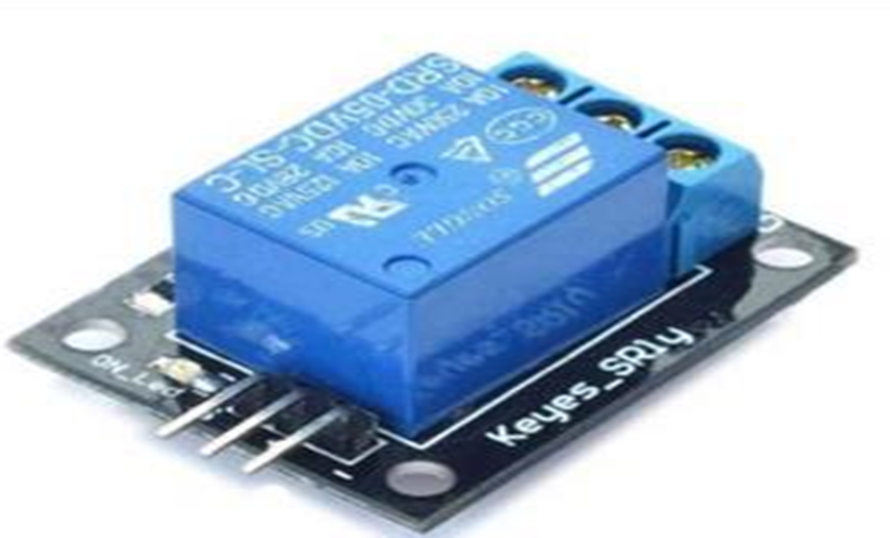
Relay
A relay is an electrically operated switch that can be used to control an electrical circuit.
It is essentially a switch that is controlled by an electromagnet, rather than by a person flipping a switch or pressing a button.
Relays can be controlled by a variety of inputs, including mechanical switches, electronic signals, and even computer programs.
They can also be used to isolate one part of an electrical circuit from another, providing a level of safety and protection for the circuit and its components.

Slide 12
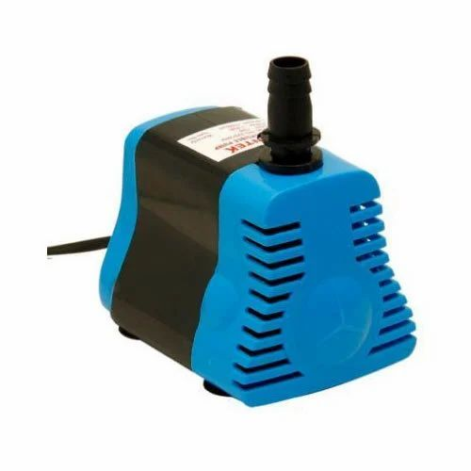
Water Pump
A water pump is a device that is used to move water from one location to another.
It is a mechanical device that uses an impeller to force water through a pipe or other conduit.
They are commonly used in a variety of applications, including irrigation, water supply, and drainage.
we have implemented an automated irrigation system that uses a water pump and a relay to control the watering of plants.
The system is designed to provide the plants with the right amount of water at the right time, without wasting water or energy

Slide 13
Technology used
IOT Technology:- IoT technology is used to collect and transmit data from various bio-monitoring devices, such as sensors and wearables, to a central hub or cloud platform. This allows for real-time monitoring and remote access to the data, as well as scalability for future expansion.
Web Technology:- Web technology refers to the various tools, languages, and frameworks used to create and maintain websites and web applications. Some common web technologies include HTML, CSS, JavaScript, and PHP. HTML (Hypertext Markup Language) is used to create the structure of a website, CSS (Cascading Style Sheets) is used to control the visual layout and design of a website, JavaScript is used to add interactive elements and dynamic functionality to a website, and PHP (Hypertext Preprocessor) is a server-side programming language that can be used to create dynamic web pages.

Slide 14
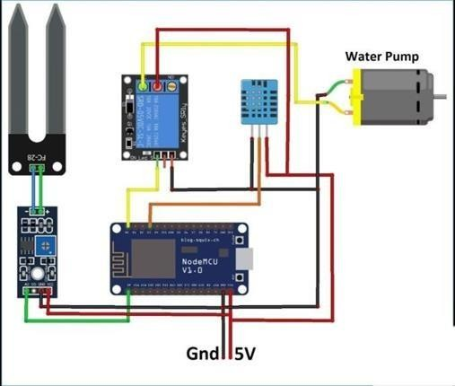
Circuit Diagram

Slide 15
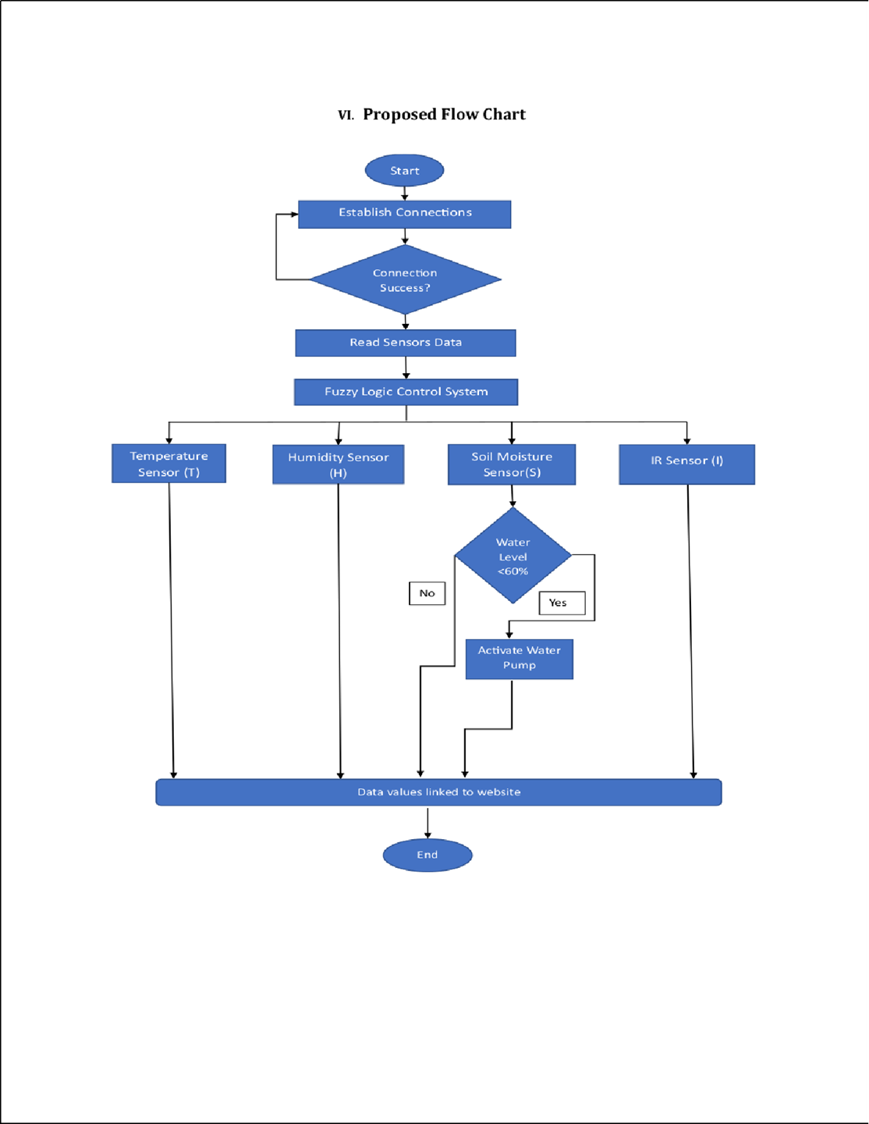
Flow Chart

Slide 16
Working
Sensor data acquisition:
Deploy various sensors in the plant environment to monitor key parameters such as temperature, humidity, soil moisture, light levels, and nutrient levels.
These sensors continuously collect data from the plant's surroundings and transmit it to the IoT gateway.
Data transmission:
The IoT gateway acts as a bridge between the sensors and the cloud platform.
It receives the sensor data wirelessly and securely transmits it to the cloud for further processing and analysis.

Slide 17
3. Cloud integration:
The collected sensor data is sent to the cloud platform where it is stored and processed.
The cloud platform utilizes data analytics techniques to analyze the plant's health, detect anomalies, and derive meaningful insights.
4. Data visualization and analysis:
The processed data is visualized through a user interface, providing real-time monitoring and insights into the plant's health.
Graphs, charts, and dashboards may be used to present the data in a user-friendly format, allowing users to track plant parameters and identify trends or issues.
5. Alert and notification system:
The smart bio-monitoring system can be configured to generate alerts and notifications based on predefined thresholds or abnormal plant conditions.
Users can receive notifications on their mobile devices or through email, enabling prompt action to be taken in response to critical plant health events.

Slide 18
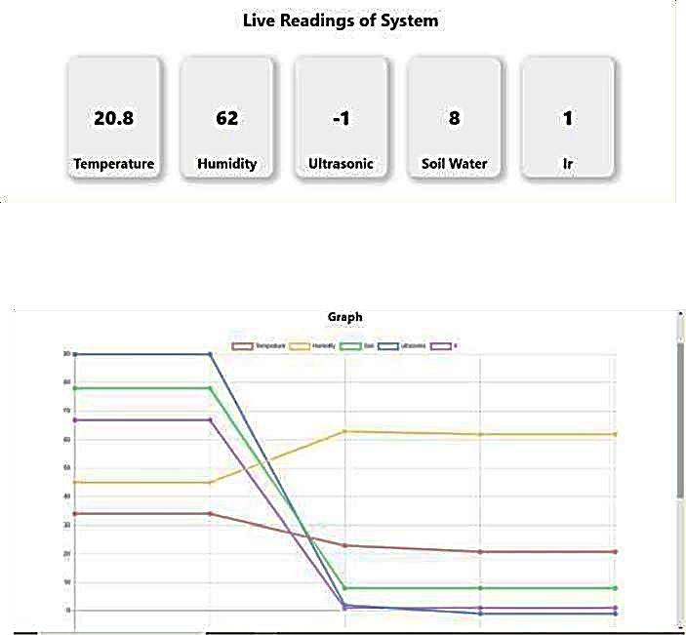
Experimentation and result

Slide 19
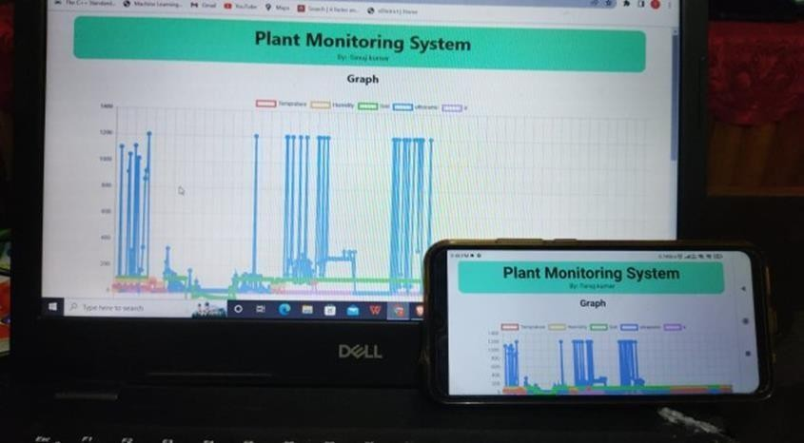
Project image

Slide 20


